Slide 1
Analyzing the Economic Liberalization of 1991 : A Gravity Model approach
Gaurav Raj, 200378

Slide 2
Table of contents
01
02
03
Abstract
Introduction
Literature review
04
05
06
Objective
Model, Variables and Hypothesis
Code
07
08
09
Results and Inferences
Plots
Data Source and References

Slide 3
ABSTRACT
The liberalisation of Economy that occurred in 1991 resulted in the opening of the market to foreign competition, which enhanced efficiency and innovation
Using the popular gravity with gravitas model of Anderson and van Wincoop (2003), we test the claim that it led to increase in trade in the Indian context.
The results suggest that India's exports and imports increased significantly, and there was a diversification in trade partners

Slide 4
INTRODUCTION
Economic Liberalisation in 1991 opened the country’s economy to foreign competition, technology and investment
It led to increase in trade and competitiveness, but the growth in sectors was not uniform
We seek to empirically verify the first; i.e., has the trade in India increased with introduction of the 1991 reforms.

Slide 5
LITERATURE REVIEW
Bhagwati and Panagariya (2002) and Ahluwalia (2001) use descriptive methods and secondary sources to analyze the impacts of the reforms and give conceptual frameworks to illustrate and confirm their arguments.
Adam and Bevan (2003) use econometric techniques to estimate the relationship between economic liberalization and economic growth, using a growth accounting framework
Anderson and van Wincoop (2003) propose a new approach to estimating the gravity model, which addresses the "border puzzle" - the fact that many bilateral trade flows are zero or near-zero despite the absence of physical or policy barriers to trade.
Guiso, Sapienza and Zingales (2008) use the gravity with gravitas model to analyse the effect of culture and economic behavior
Giovanni and Levchenko (2009) explore trade openness and volatility using Anderson and van Wincoop's model

Slide 6
OBJECTIVE
Through the use of Anderson and van Wincoop's (2003) gravity with gravitas model, we seek to develop a quantitative equation to describe the effects of the liberalization policy of 1991 in the context of India's trade
For this, we take 41 years of GDP and Trade data from 1970 to 2010
The data is taken for the following trade partners of India (top 10 trade partners by total trade (Wikipedia)) :
Hong Kong SAR, China
Indonesia
UAE
USA
China
Saudi Arabia
Russian Federation
Germany
South Korea
Malaysia

Slide 7
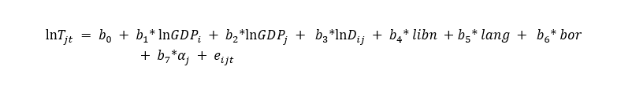
MODEL
We use a gravity model with additional liberalization, language, border and MR terms, which are explained as follows

Slide 8
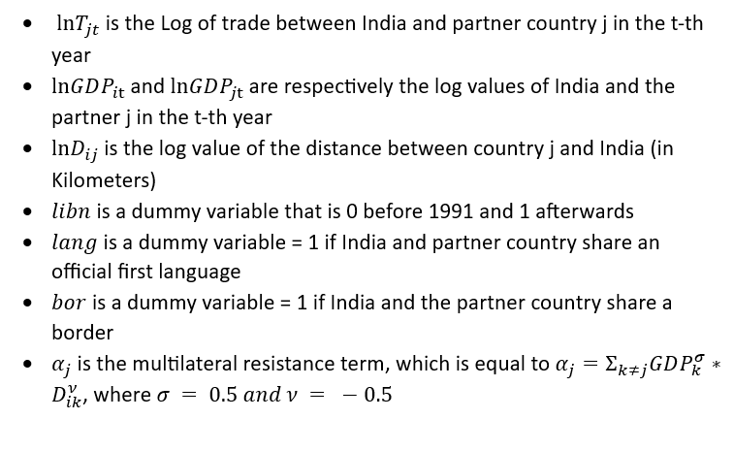
VARIABLES

Slide 9
HYPOTHESIS
A positive and significant coefficient for the dummy libn, which would indicate that the reforms of 1991 did actually impact trade in India
The coefficients of GDP and distance are both expected to be significant, although differing in signs
I would also expect a positive coefficient for the variable lang and bor.

Slide 10
DATASET PREPARATION
Trade data was extracted from data.imf.org
GDP data was extracted from databank.worldbank.org
Distance data was taken from Wikipedia
Lang and border data were taken from Wikipedia
A column for MR term was then created according to the formula mentioned

Slide 11
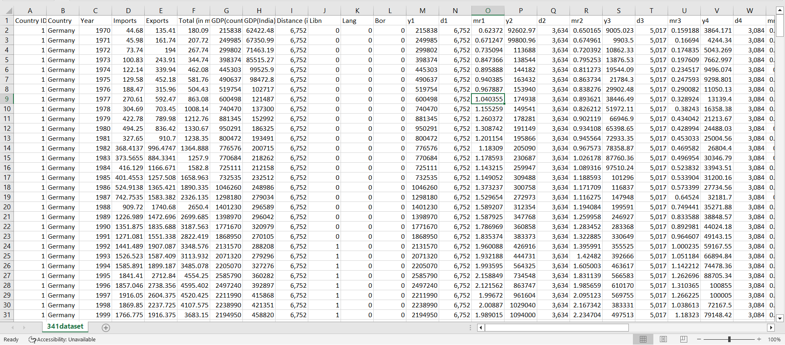
Dataset Screenshot

Slide 12
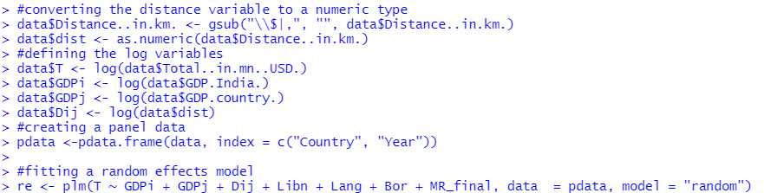
Methodology and Coding
The full code can be accessed here
R has been used for coding as it provides more flexibility in terms of model definitions
‘plm’ library has been used for panel data regression
BP test suggests that random effects model should be used (p-value for BP test = 0.97)
This is in line with our methodology, as a chunk of out assumed significant variables capture time invariant effects

Slide 13
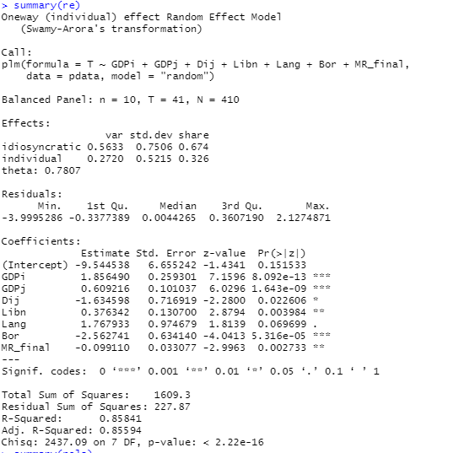
Results
The coefficients for GDP of both India and the partner country are positive and significant
Coefficient for Distance is negative and significant
Liberalization has a positive and significant coefficient, thus proving our hypothesis and demonstrating that trade was indeed positively affected by the policies of 1991
Language turns out to be positive but insignificant, and counter-intuitively, border turns out to be significant but negatively related with trade
The Multilateral Resistance term coefficient is negative and significant

Slide 14
Conclusion
As expected, the coefficients of GDP of India and the partner countries are positive, validating the gravity model
The negative coefficient for the distance term is in line with the gravity model
Of particular interest is the libn coefficient, which is both significant and positive, thus validating our hypothesis
The negative multilateral resistance term validates Anderson’s model which suggests that trade with other countries influences trade with a partner
This exercise, thus validates the gravity model as well as proves our hypothesis true.

Slide 15
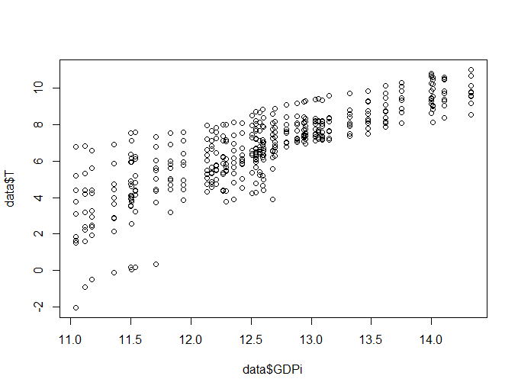
Log(trade) vs log(GDP_india)

Slide 16
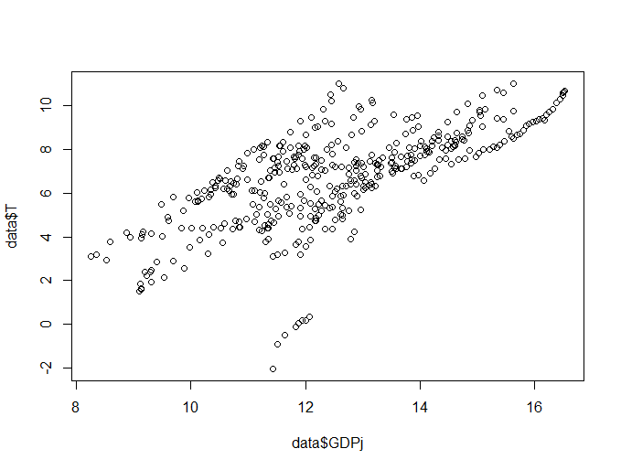
Log(trade) vs log(GDP_j)

Slide 17
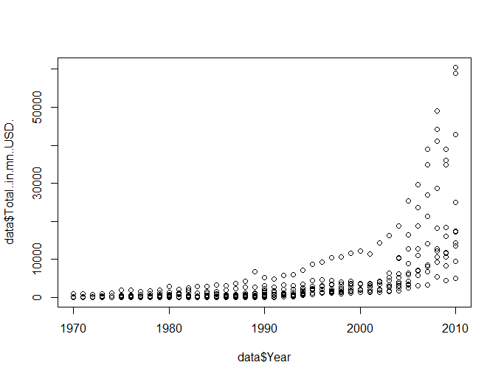
Log(trade) vs Year

Slide 18
REFERENCES
Jeffrey Frankel and Andrew Rose, “An Estimate of the Effect of Common Currencies on Trade and Income”, The Quarterly Journal of Economics, Volume 117, Issue 2, May 2002, Pages 437–466
Luigi Guiso, Paola Sapienza and Luigi Zingales, “Cultural Biases in Economic Exchange?”, The Quarterly Journal of Economics, Volume 124, Issue 3, August 2009, Pages 1095–1131
David S Jacks and Krishna Pendakur, “Global Trade and the Maritime Transport Revolution”, The Review of Economics and Statistics (2010) 92 (4), Pages 745–755
James E. Anderson, Eric van Wincoop, “Gravity with Gravitas: A Solution to the Border Puzzle”, The American Economic Review, Vol. 93, No. 1 (Mar., 2003), pp. 170-192

Slide 19
THANK YOU

